Slide 1
Traffic Light Controller
Hardware Engineering Lab
TEAM E
Nnaemeka Valentine Eze
Onyesi John Abiagam
Manoj Luitel

Slide 2
Motivation
Traditional traffic control
Human-Dependent
Error prone
Traffic management systems
Safety requirements
Efficiency
Reliability

Slide 3
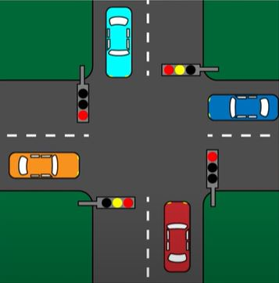
Problem Description
Consider a farmstead with a junction East, West, North and South;
Each has a Pedestrian with a Push-button.
Cars can only pass in either orientation at a time
A push button at E or West Triggers a stop of traffic at EW and a Go at NS.
A push-button at N or S triggers a Stop at NS and a Go at EW.

Slide 4
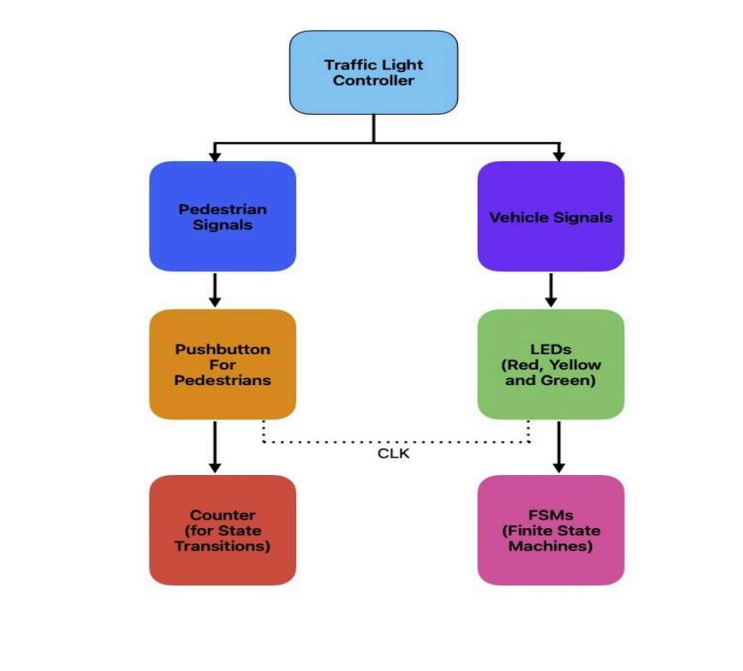
Concept Draft

Slide 5
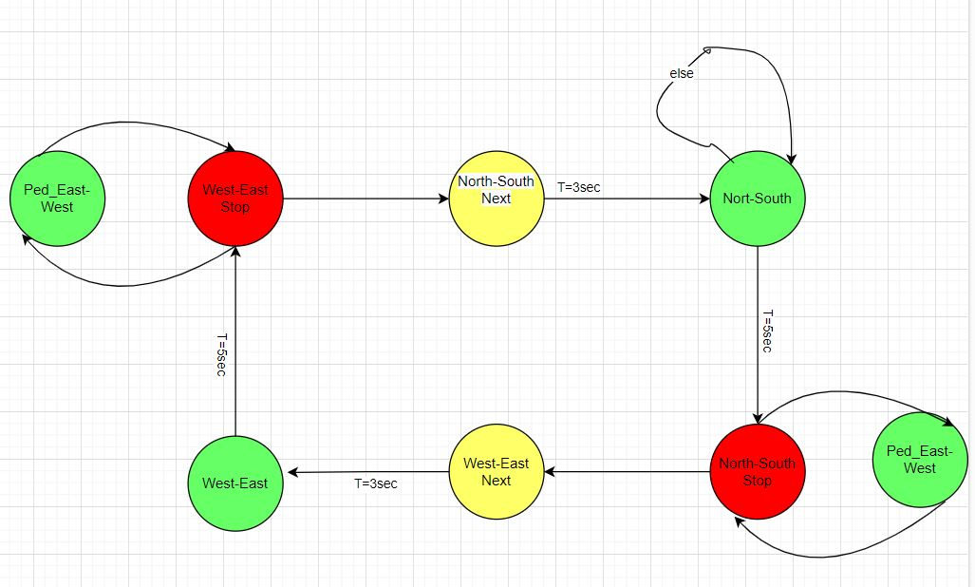
Finite State Machine
Nature: Mealy FSM
No of States: 6 Finite States
Inputs: 2
Outputs:

Slide 6
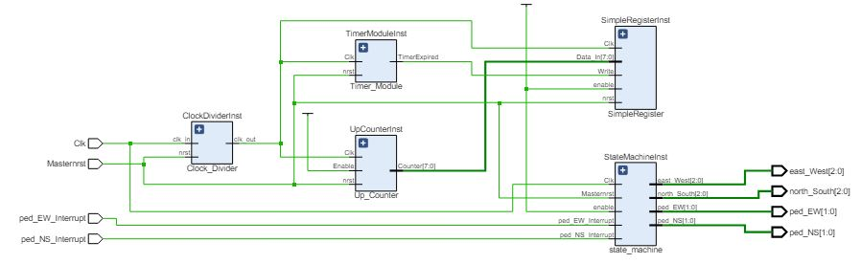
Implementation Summary
Creating a New Project
Adding Source Files
Defining Constraint
Simulation
Design Synthesis
Implementing the Design
Generating Bitstream

Slide 7
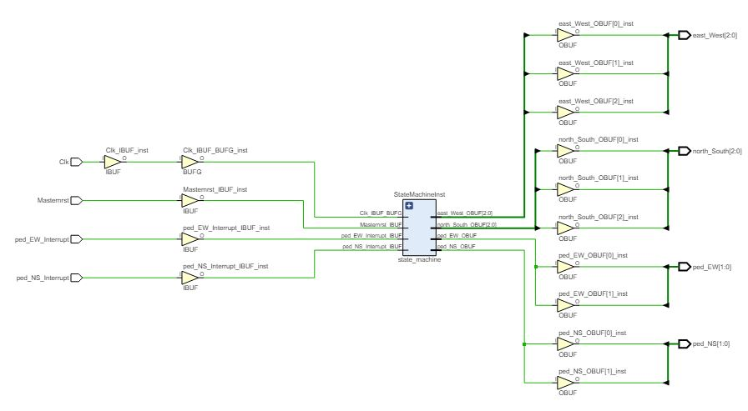
Schematic

Slide 8
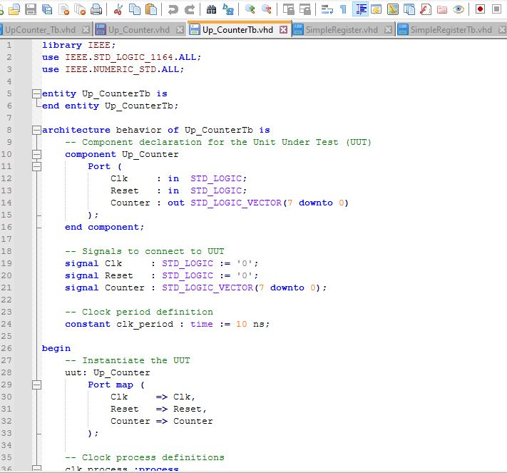
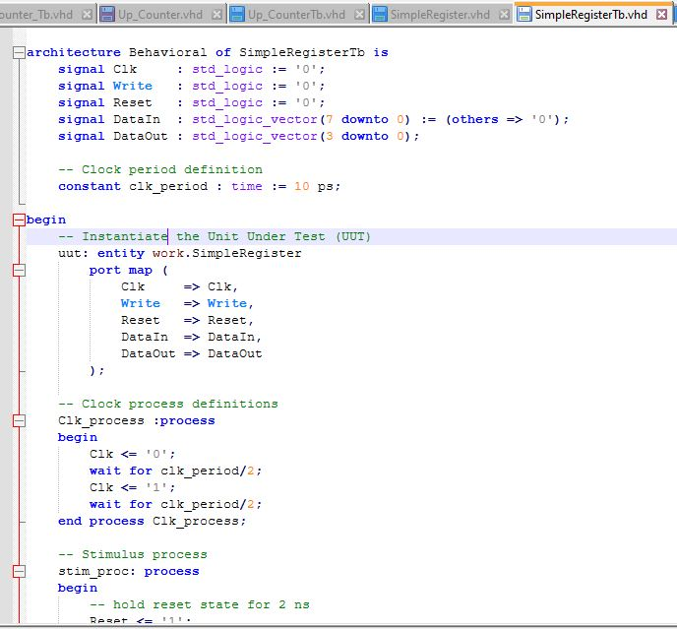
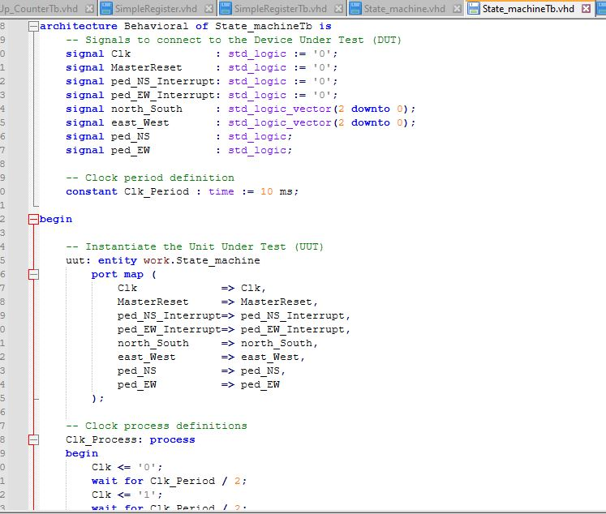
Testbench

Slide 9
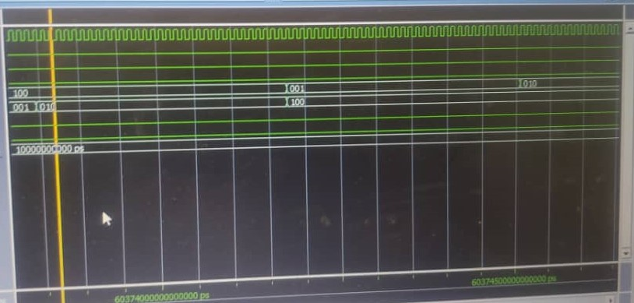
Waveform

Slide 10
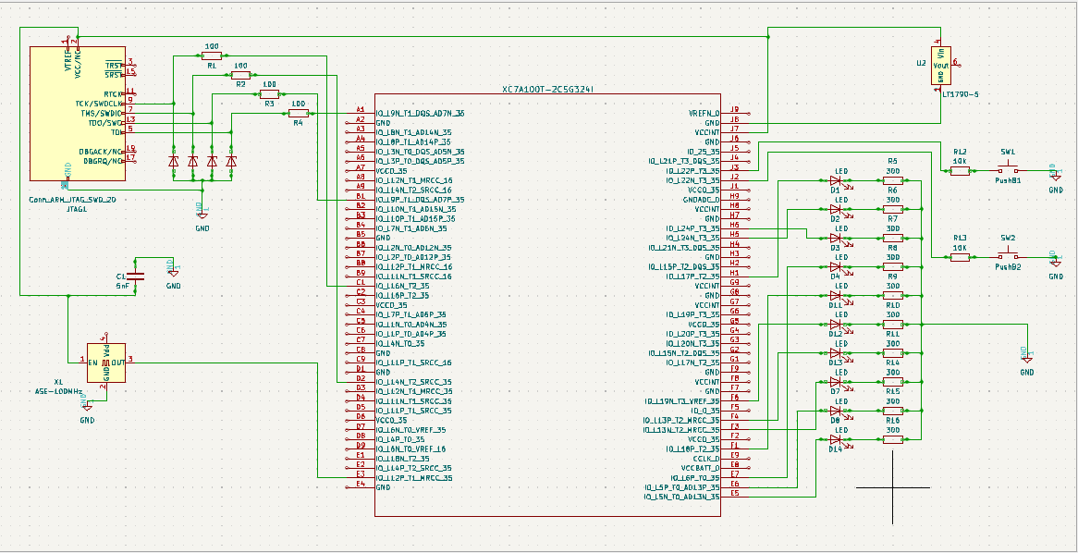
PCB Design:Schematic
Insert text

Slide 11
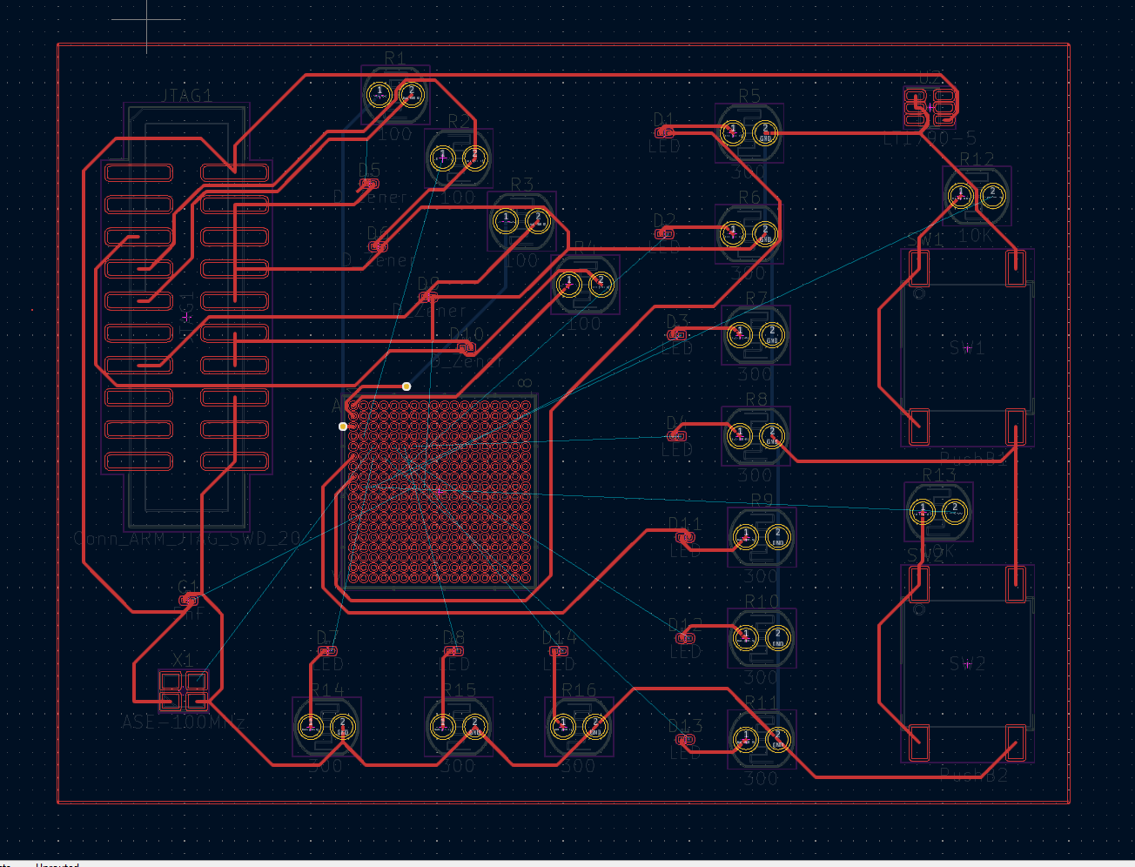
PCB Layout and 3D View

Slide 12
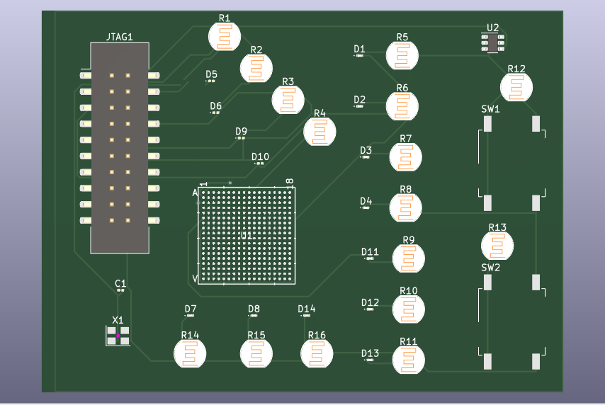

Slide 13
Conclusion

